Slide 1
Predictive maintenance of industrial machinery
IBM AICTE MACHINE LEARNING PROJECT
Presented By:
Student Name - Naveen Prian V
College Name - Sri Krishna College of Technology
Department - Electronics and Communication Engineering

Slide 2
OUTLINE
Problem Statement (Should not include solution)
Proposed System/Solution
System Development Approach (Technology Use of IBM cloud lite services )
Algorithm & Deployment
Result (Output Image)
Conclusion
Future Scope
References

Slide 3
Problem Statement
Example: Industrial machinery failures lead to unplanned downtimes, increased operational costs, and reduced productivity. Traditional maintenance practices are either reactive or scheduled without considering the actual health of the machine. This project aims to develop a predictive maintenance model using machine learning techniques to analyze real-time sensor data from industrial equipment and accurately predict potential failures such as tool wear, heat dissipation issues, or power failures before they occur. Leveraging the IBM Cloud Lite platform, the solution will classify failure types and enable proactive maintenance, thereby minimizing unexpected breakdowns and optimizing machine performance.

Slide 4
Proposed Solution
The proposed system aims to address the challenge of predicting the potential failures in industrial machinery and enable proactive maintenance. Leveraging the IBM cloud lite platform the solution will classify failure types and enable proactive maintenance, thereby unexpected breakdowns. The solution will consist of the following components:
Data Collection:
Load the dataset from Kaggle into your working environment Gather operational data on sensor data, operational Settings, Failure lables, and other relevant factors.
Utilize real-time operational data sources, such as tool wear, heat dissipation, and power failure, to enhance prediction accuracy.
Data Preprocessing:
Auto AI handles missing values, encoding of categorical variables, and scaling of numeric features..
Automatically detects the prediction column target : Failure type.
Machine Learning Algorithm:
Implement a machine learning algorithm, such as a Random Forest classifier (e.g.,SVM, XGBoost, Logistic, Regression), to predict the type of failure.
Automatically estimates feature importance, helping us understand which sensor readings contribute most to failure prediction.
Deployment:
Develop a user-friendly interface or application that provides real-time predictions for patterns that precede a failure .
Ready for real-time predications from sensor inputs.
Evaluation:
After training the classification model, its performance was evaluated using standard machine learning metrics to ensure reliability and effectiveness in predicting.
Achieved high prediction confidence (100%) across test records, which may require further feature tuning or additional data.
Result: The deployed Random Forest Classification Model was tested on real-time sensor input using IBM Watsonx.ai. The model demonstrated perfect prediction accuracy on the test data provided.

Slide 5
System Approach
To address the challenge of predicting industrial machinery failures before they occur, a systematic, step-by-step machine learning pipeline was followed. The system integrates data analysis, model training, and cloud deployment using IBM Cloud Lite services.:
System requirements - IBM Cloud lite services , Cloud Object Storage
Library required to build the model – IBM Cloud Watsonx.ai Studio, IBM Cloud Watsonx.ai Runtime

Slide 6
Algorithm & Deployment
In the Algorithm section, describe the machine learning algorithm chosen for predicting the type of failure. Here's an example structure for this section:
Algorithm Selection:
Provide a brief overview of the chosen algorithm (e.g., Random Forest Classifier model, like SVM or Logistic Regression) and justify its selection based on the problem statement and data characteristics.
Data Input:
Specify the input features used by the algorithm, such as sensor readings and machine characteristics failure prediction, and any other relevant factors.
Training Process:
Explain how the algorithm is trained using operational data. It learns to detect patterns in the sensor readings that are predictive of specific failures, enabling proactive maintenance and downtime reduction.
Prediction Process:
The trained model receives real-time sensor data from industrial machines as input. Based on learned patterns, it predicts the specific type of failure (or no failure), enabling timely maintenance actions.

Slide 7
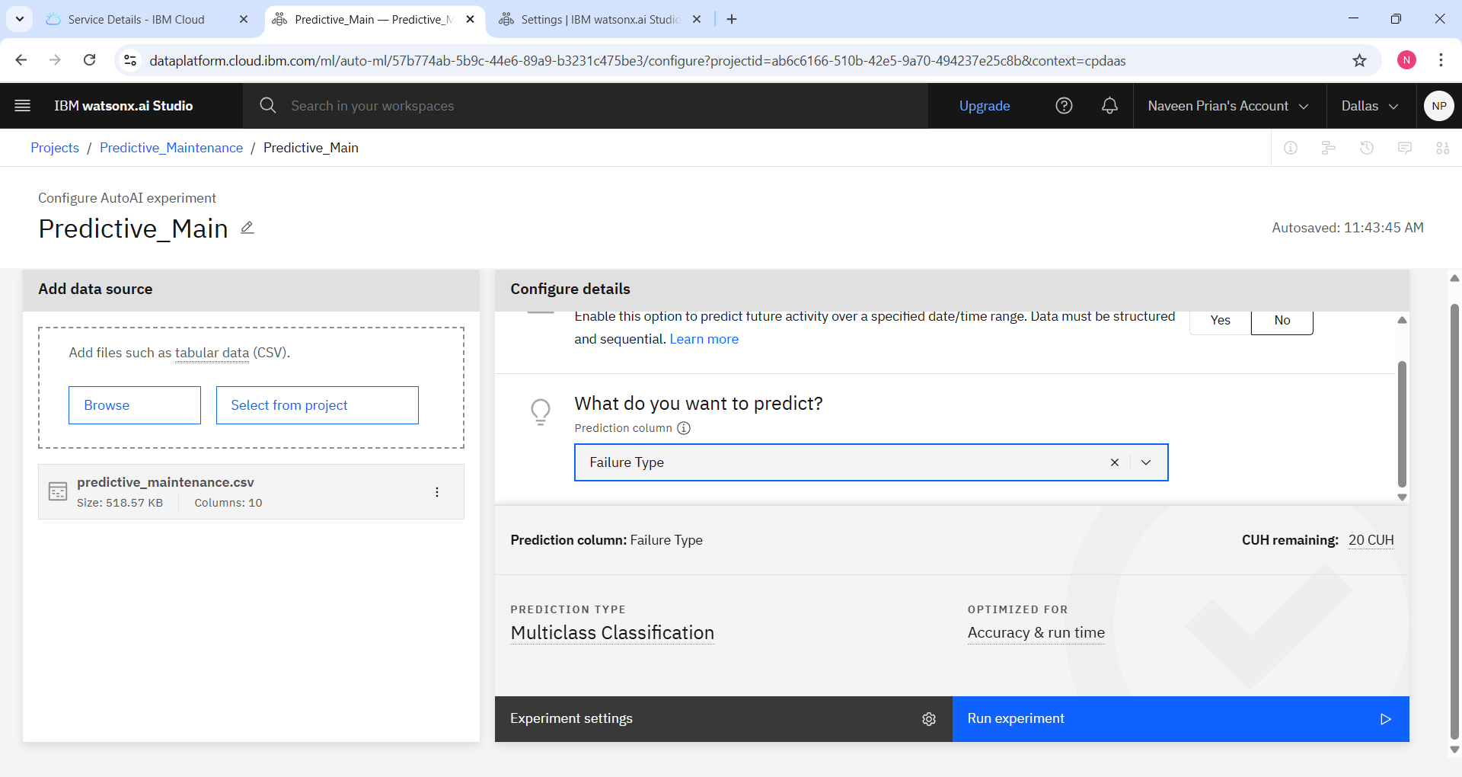
Result

Slide 8
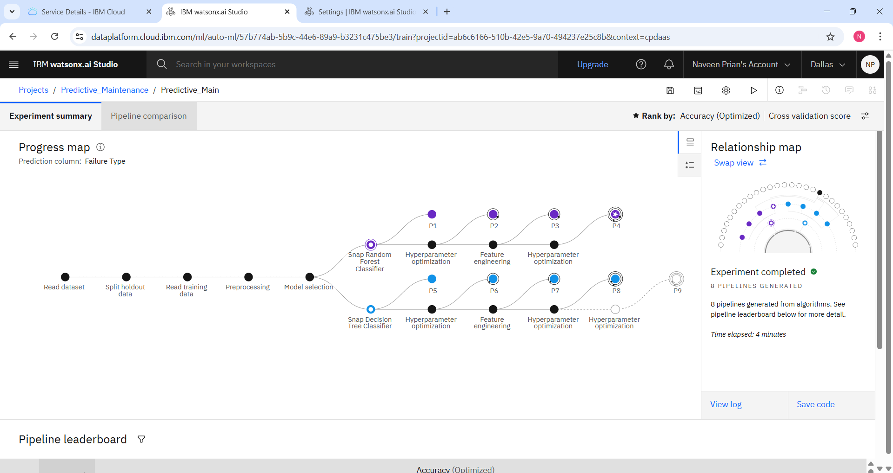
Experiment summary

Slide 9
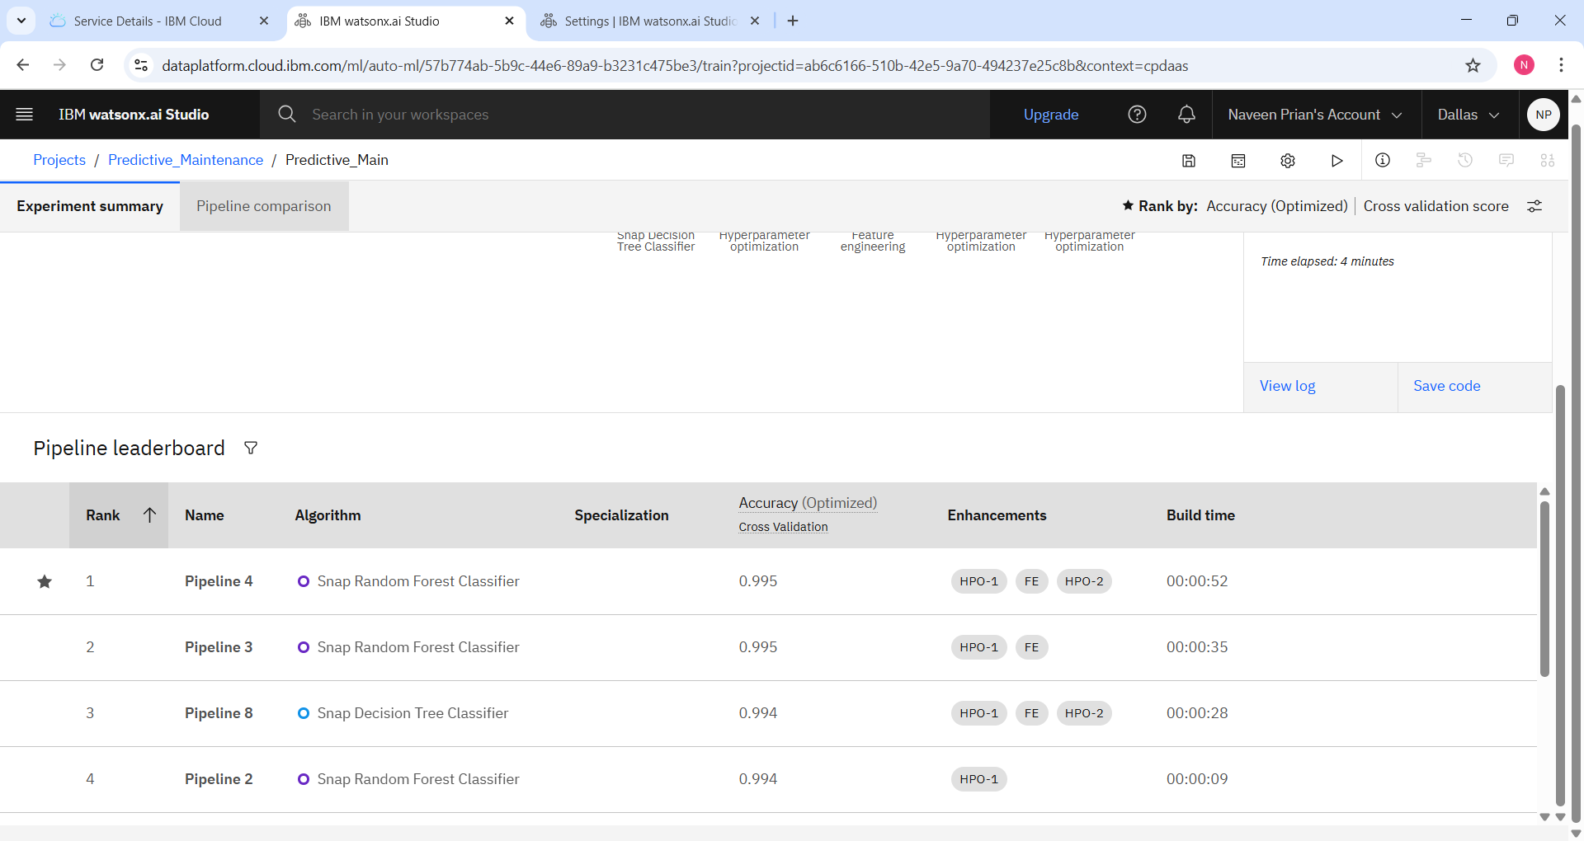
Pipeline comparison

Slide 10
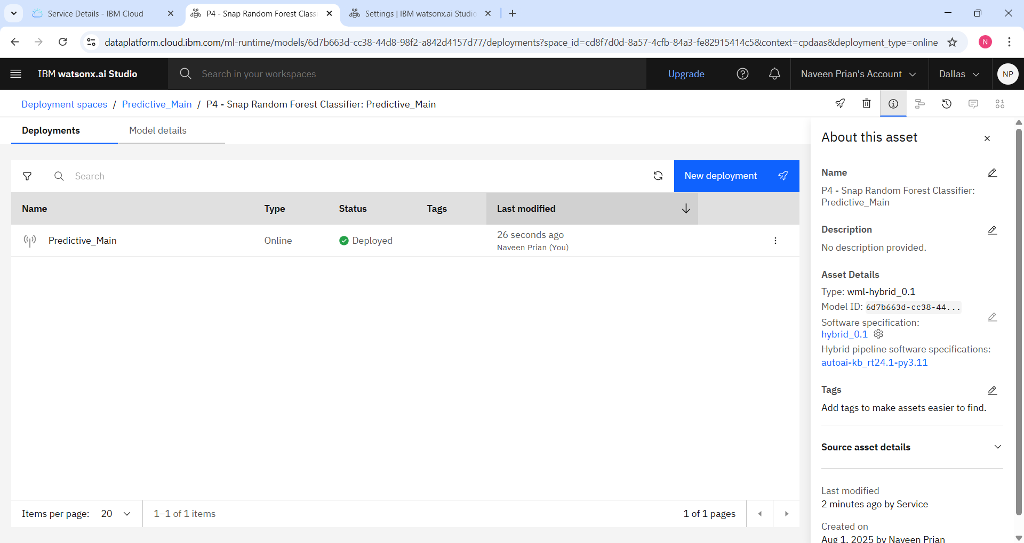
Deployment spaces

Slide 11
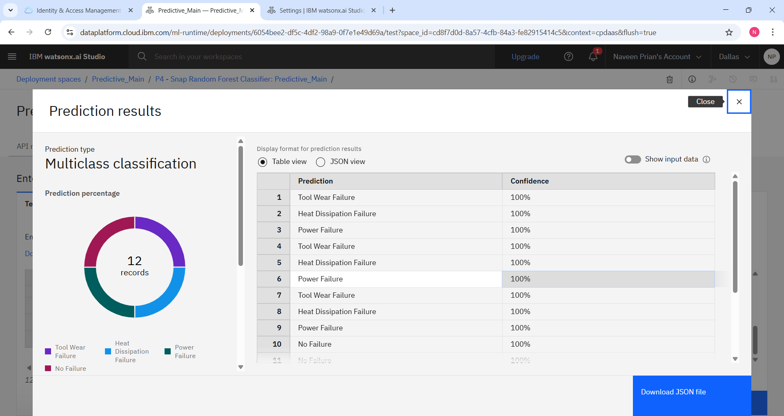
Prediction results

Slide 12
Conclusion
In this project, we developed a predictive maintenance model using IBM Cloud Lite services and real-time sensor data to anticipate industrial machine failures. By implementing a multiclass classification model, we successfully predicted failure types such as Tool Wear, Heat Dissipation, and Power Failure with high accuracy. This model enables proactive maintenance strategies, minimizing downtime, reducing operational costs, and improving overall equipment efficiency. The solution demonstrates the practical value of machine learning in enhancing industrial reliability and performance.

Slide 13
Future scope
Real-Time Monitoring : Integrate IoT and sensor-based edge devices for continuous real-time equipment health tracking.
Advanced ML Models : Deploy deep learning techniques (e.g., LSTM, CNN) for improved accuracy in predicting complex failure patterns.
Industry-Wide Deployment : Scale the model across multiple industries like aerospace, automotive, and energy sectors.
Automated Maintenance workflow : Connect the model with maintenance scheduling systems for automatic alerts and actions.
Cloud - Based Dashboards : Develop intuitive dashboards on IBM Cloud to visualize predictions and machine health status.

Slide 14
References
Shivamb, Machine Predictive Maintenance Classification Dataset, Kaggle. https://www.kaggle.com/datasets/shivamb/machine-predictive-maintenance-classification
IBM Cloud Documentation, IBM. https://cloud.ibm.com/docs
Scikit-learn Developers, Machine Learning in Python, https://scikit-learn.org/stable/
IBM Watson Studio: Build and train models. https://www.ibm.com/cloud/watson-studio

Slide 15
Github link
Git hub Link : https://github.com/naveenip05/Predictive-Maintenance-of-Industrial-Machinery

Slide 16
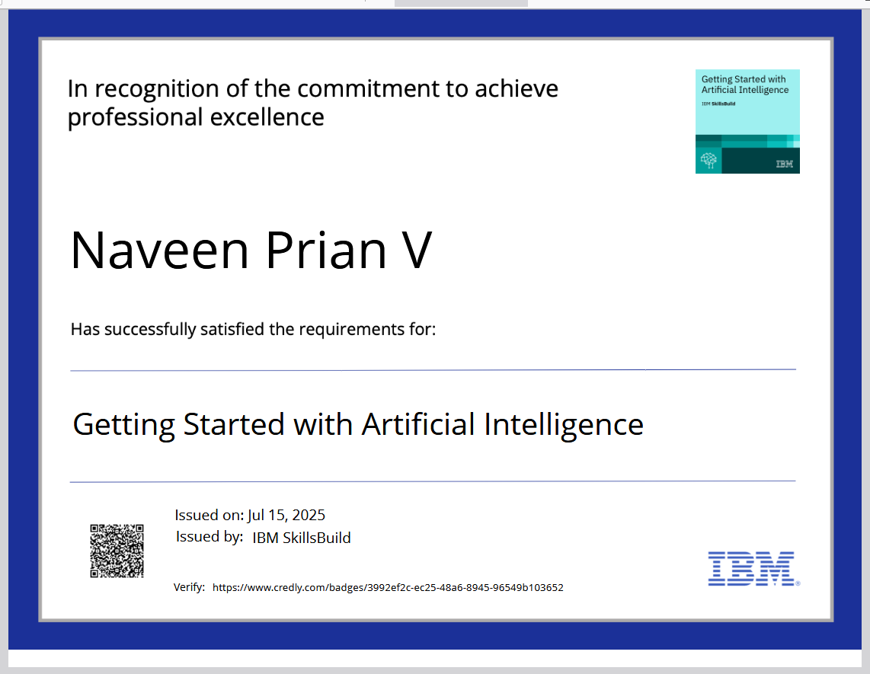
IBM Certifications

Slide 17
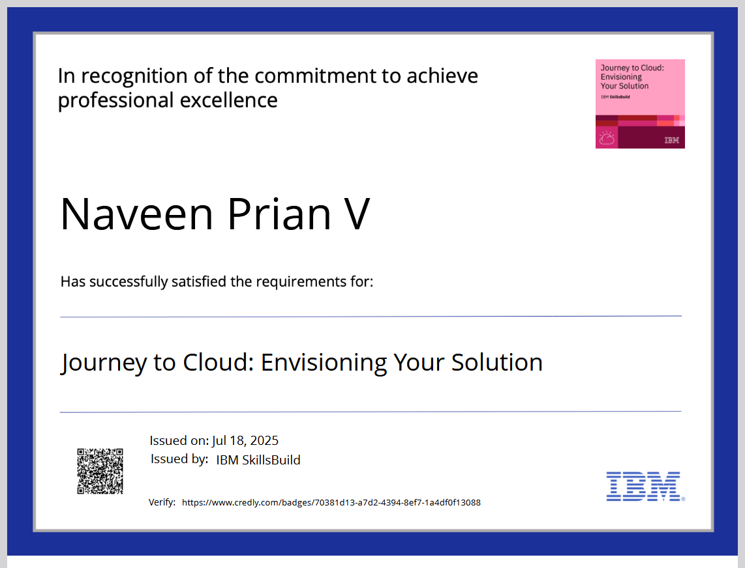
IBM Certifications

Slide 18
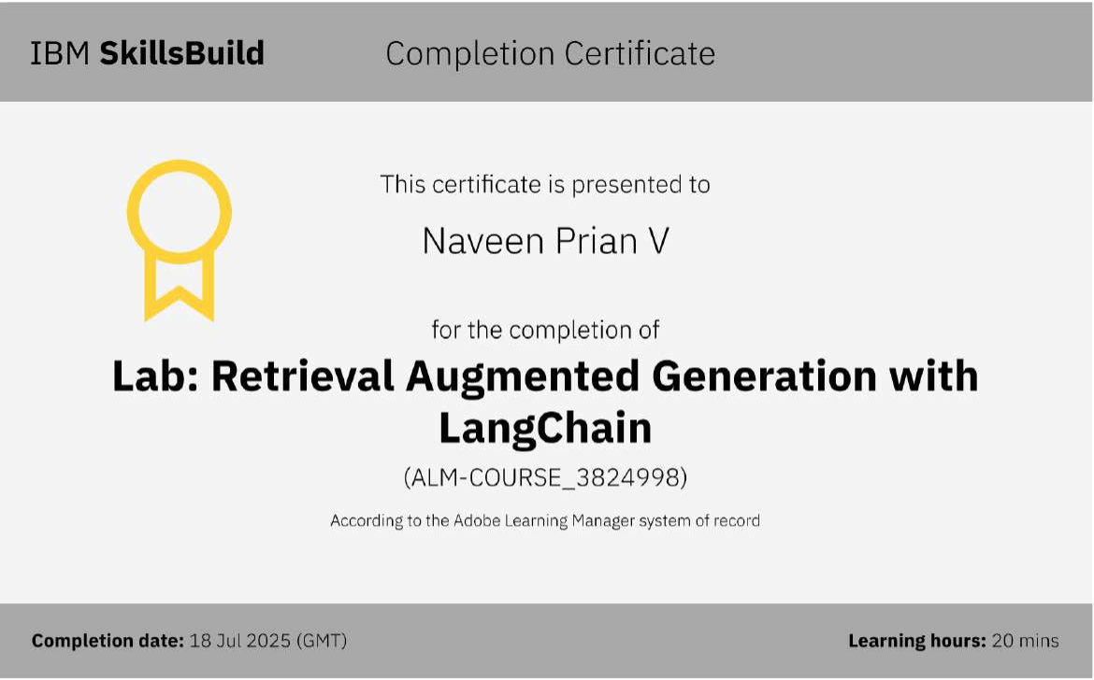
IBM Certifications

Slide 19
THANK YOU

